Slide 1
Quadrilateral Angles
From nRich Strange Rectangle
384

Slide 2




Quadrilateral Angles
$$C \left(1,5\right)$$
(Not to scale)
$$B \left(7,3\right)$$
$$\left(0,2\right) D$$
$$A \left(1,0\right)$$
Determine the angles in the quadrilateral using trigonometric compound angle formulae.

Slide 3






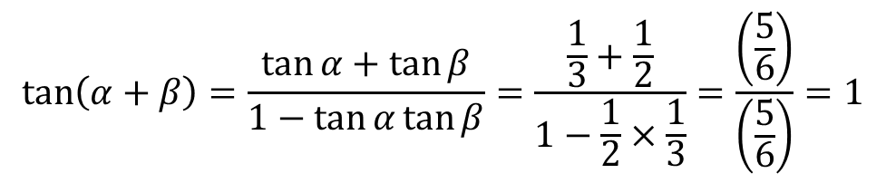

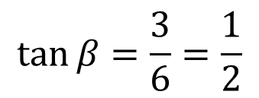


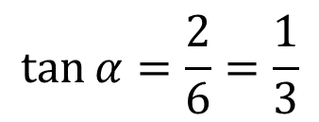
Quadrilateral Angles
$$C \left(1,5\right)$$
$$6$$
$$\tan{α}=\frac{2}{6}=\frac{1}{3}$$
$$α$$
$$2$$
$$α$$
$$B \left(7,3\right)$$
$$β$$
$$\left(0,2\right) D$$
$$3$$
$$β$$
$$\tan{β}=\frac{3}{6}=\frac{1}{2}$$
$$A \left(1,0\right)$$
$$6$$
$$\tan\left(α+β\right)=\frac{\tan{α}+\tan{β}}{1−\tan{α}\tan{β}}=\frac{\frac{1}{3}+\frac{1}{2}}{1−\frac{1}{2}×\frac{1}{3}}=\frac{\left(\frac{5}{6}\right)}{\left(\frac{5}{6}\right)}=1$$
$$α+β=45°$$

Slide 4






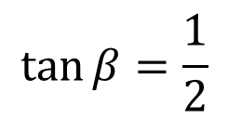


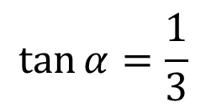
Quadrilateral Angles
$$1$$
$$C \left(1,5\right)$$
$$6$$
$$\tan{α}=\frac{1}{3}$$
$$α$$
$$2$$
$$3$$
$$B \left(7,3\right)$$
$$45°$$
$$α$$
$$\left(0,2\right) D$$
$$135°$$
$$3$$
$$2$$
$$β$$
$$β$$
$$\tan{β}=\frac{1}{2}$$
$$1$$
$$A \left(1,0\right)$$
$$6$$

Slide 5

Quadrilateral Angles
$$C \left(1,5\right)$$
(Not to scale)
How was it possible to produce so many different worksheets with the same angles?
$$B \left(7,3\right)$$
$$45°$$
$$D$$
$$\left(0,2\right)$$
$$135°$$
$$A \left(1,0\right)$$
Determine the angles in the quadrilateral.

Slide 6


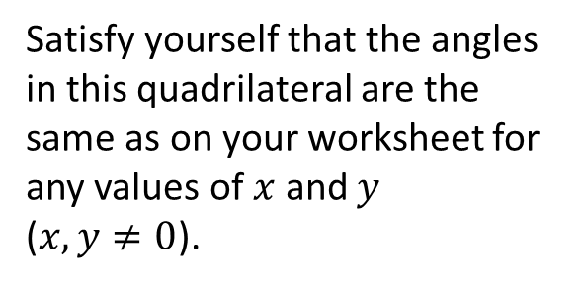




Quadrilateral Angles
$$y\left(x−y\right)$$
$$x\left(x+y\right)$$
$$x\left(x−y\right)$$
$$y\left(x+y\right)$$
Satisfy yourself that the angles in this quadrilateral are the same as on your worksheet for any values of $x$ and $y$
($x,y≠0$).
$$y\left(x+y\right)$$
$$x\left(x−y\right)$$
$$y\left(x−y\right)$$
$$x\left(x+y\right)$$
Various values of $x$ and $y$ were used to create the coordinates on the worksheets.

Slide 7



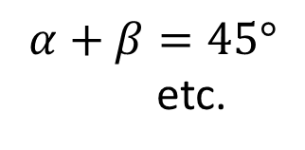
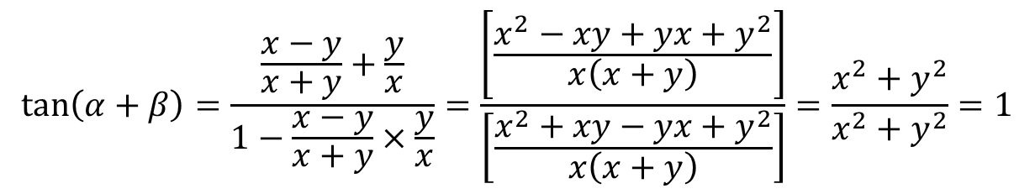



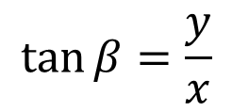


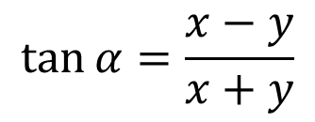
Quadrilateral Angles
$$C$$
$$x\left(x+y\right)$$
$$\tan{α}=\frac{x−y}{x+y}$$
$$α$$
$$x\left(x−y\right)$$
$$α$$
$$B$$
$$β$$
$$D$$
$$y\left(x+y\right)$$
$$β$$
$$\tan{β}=\frac{y}{x}$$
$$A$$
$$x\left(x+y\right)$$
$$\tan\left(α+β\right)=\frac{\frac{x−y}{x+y}+\frac{y}{x}}{1−\frac{x−y}{x+y}×\frac{y}{x}}=\frac{\left[\frac{x^{2}−xy+yx+y^{2}}{x\left(x+y\right)}\right]}{\left[\frac{x^{2}+xy−yx+y^{2}}{x\left(x+y\right)}\right]}=\frac{x^{2}+y^{2}}{x^{2}+y^{2}}=1$$
$$α+β=45°$$
etc.

Slide 9
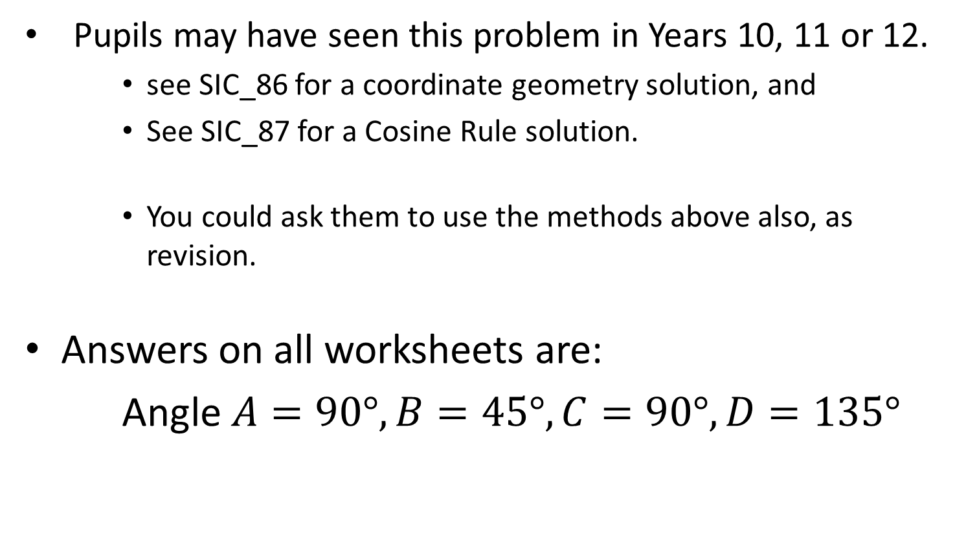
Note to Teacher
  Pupils may have seen this problem in Years 10, 11 or 12.
    see SIC_86 for a coordinate geometry solution, and
    See SIC_87 for a Cosine Rule solution.
    You could ask them to use the methods above also, as revision.
Answers on all worksheets are:
Angle $A=90°, B=45°, C=90°, D=135°$

Slide 10
RESOURCES

Slide 11

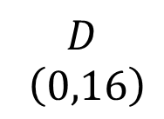


Quadrilateral Angles
SIC_88
$$C \left(8,40\right)$$
(Not to scale)
$$B \left(56,24\right)$$
$$D$$
$$\left(0,16\right)$$
$$A \left(8,0\right)$$
A
Determine the angles in the quadrilateral using trigonometric compound angle formulae.
Notes:
X=6, y=2

Slide 12

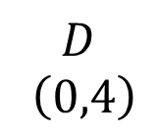


Quadrilateral Angles
SIC_88
$$C \left(2,10\right)$$
(Not to scale)
$$B \left(14,6\right)$$
$$D$$
$$\left(0,4\right)$$
$$A \left(2,0\right)$$
B
Determine the angles in the quadrilateral using trigonometric compound angle formulae.
Notes:
X=3, y=1

Slide 13

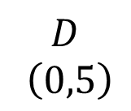


Quadrilateral Angles
SIC_88
$$C \left(3,17\right)$$
(Not to scale)
$$B \left(23,12\right)$$
$$D$$
$$\left(0,5\right)$$
$$A \left(3,0\right)$$
C
Determine the angles in the quadrilateral using trigonometric compound angle formulae.
Notes:
X=4, y=1

Slide 14
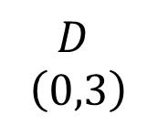


Quadrilateral Angles
SIC_88
$$C \left(2,13\right)$$
(Not to scale)
$$B \left(17,10\right)$$
$$D$$
$$\left(0,3\right)$$
$$A \left(2,0\right)$$
D
Determine the angles in the quadrilateral using trigonometric compound angle formulae.
Notes:
X=3, y=2

Slide 15

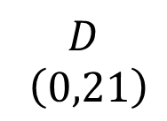


Quadrilateral Angles
SIC_88
$$C \left(12,65\right)$$
(Not to scale)
$$B \left(89,44\right)$$
$$D$$
$$\left(0,21\right)$$
$$A \left(12,0\right)$$
E
Determine the angles in the quadrilateral using trigonometric compound angle formulae.
Notes:
X=7, y=4

Slide 16

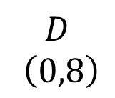


Quadrilateral Angles
SIC_88
$$C \left(4,20\right)$$
(Not to scale)
$$B \left(28,12\right)$$
$$D$$
$$\left(0,8\right)$$
$$A \left(4,0\right)$$
F
Determine the angles in the quadrilateral using trigonometric compound angle formulae.
Notes:
X=4, y=2

Slide 17



Quadrilateral Angles
SIC_88
$$C \left(6,50\right)$$
(Not to scale)
$$B \left(62,42\right)$$
$$D$$
$$\left(0,8\right)$$
$$A \left(6,0\right)$$
G
Determine the angles in the quadrilateral using trigonometric compound angle formulae.
Notes:
X=7, y=4

Slide 18


Quadrilateral Angles
SIC_88
$$C \left(3,25\right)$$
(Not to scale)
$$B \left(31,21\right)$$
$$D$$
$$\left(0,4\right)$$
$$A \left(3,0\right)$$
H
Determine the angles in the quadrilateral using trigonometric compound angle formulae.
Notes:
X=4, y=3

Slide 19
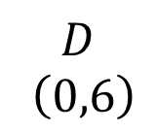


Quadrilateral Angles
SIC_88
$$C \left(4,26\right)$$
(Not to scale)
$$B \left(34,20\right)$$
$$D$$
$$\left(0,6\right)$$
$$A \left(4,0\right)$$
I
Determine the angles in the quadrilateral using trigonometric compound angle formulae.
Notes:
X=5, y=1

Slide 20
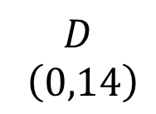


Quadrilateral Angles
SIC_88
$$C \left(6,29\right)$$
(Not to scale)
$$B \left(41,15\right)$$
$$D$$
$$\left(0,14\right)$$
$$A \left(6,0\right)$$
J
Determine the angles in the quadrilateral using trigonometric compound angle formulae.
Notes:
X=5, y=2

Slide 21
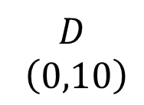


Quadrilateral Angles
SIC_88
$$C \left(6,34\right)$$
(Not to scale)
$$B \left(46,24\right)$$
$$D$$
$$\left(0,10\right)$$
$$A \left(6,0\right)$$
K
Determine the angles in the quadrilateral using trigonometric compound angle formulae.
Notes:
X=5, y=3

Slide 22


Quadrilateral Angles
SIC_88
$$C \left(4,41\right)$$
(Not to scale)
$$B \left(49,36\right)$$
$$D$$
$$\left(0,5\right)$$
$$A \left(4,0\right)$$
L
Determine the angles in the quadrilateral using trigonometric compound angle formulae.
Notes:
X=5, y=4

Slide 23
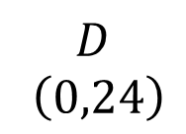

Quadrilateral Angles
SIC_88
$$C \left(8,40\right)$$
(Not to scale)
$$D$$
$$\left(0,24\right)$$
$$B \left(56,16\right)$$
$$A \left(8,0\right)$$
M
Determine the angles in the quadrilateral using trigonometric compound angle formulae.
Notes:
X=6, y=2

Slide 24
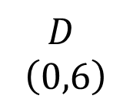

Quadrilateral Angles
SIC_88
$$C \left(2,10\right)$$
(Not to scale)
$$D$$
$$\left(0,6\right)$$
$$B \left(14,4\right)$$
$$A \left(2,0\right)$$
N
Determine the angles in the quadrilateral using trigonometric compound angle formulae.
Notes:
X=3, y=1

Slide 25
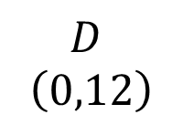

Quadrilateral Angles
SIC_88
$$C \left(3,17\right)$$
(Not to scale)
$$D$$
$$\left(0,12\right)$$
$$B \left(23,5\right)$$
$$A \left(3,0\right)$$
O
Determine the angles in the quadrilateral using trigonometric compound angle formulae.
Notes:
X=4, y=1

Slide 26

Quadrilateral Angles
SIC_88
$$C \left(2,13\right)$$
(Not to scale)
$$D$$
$$\left(0,10\right)$$
$$B \left(17,3\right)$$
$$A \left(2,0\right)$$
P
Determine the angles in the quadrilateral using trigonometric compound angle formulae.
Notes:
X=3, y=2

Slide 27
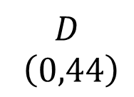

Quadrilateral Angles
SIC_88
$$C \left(12,65\right)$$
(Not to scale)
$$D$$
$$\left(0,44\right)$$
$$B \left(89,21\right)$$
$$A \left(12,0\right)$$
Q
Determine the angles in the quadrilateral using trigonometric compound angle formulae.
Notes:
X=7, y=4

Slide 28
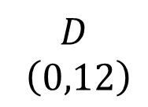

Quadrilateral Angles
SIC_88
$$C \left(4,20\right)$$
(Not to scale)
$$D$$
$$\left(0,12\right)$$
$$B \left(28,8\right)$$
$$A \left(4,0\right)$$
R
Determine the angles in the quadrilateral using trigonometric compound angle formulae.
Notes:
X=4, y=2

Slide 29
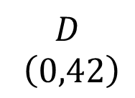

Quadrilateral Angles
SIC_88
$$C \left(6,50\right)$$
(Not to scale)
$$D$$
$$\left(0,42\right)$$
$$B \left(62,8\right)$$
$$A \left(6,0\right)$$
S
Determine the angles in the quadrilateral using trigonometric compound angle formulae.
Notes:
X=7, y=4

Slide 30

Quadrilateral Angles
SIC_88
$$C \left(3,25\right)$$
(Not to scale)
$$D$$
$$\left(0,21\right)$$
$$B \left(31,4\right)$$
$$A \left(3,0\right)$$
T
Determine the angles in the quadrilateral using trigonometric compound angle formulae.
Notes:
X=4, y=3

Slide 31
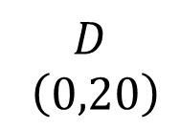

Quadrilateral Angles
SIC_88
$$C \left(4,26\right)$$
(Not to scale)
$$D$$
$$\left(0,20\right)$$
$$B \left(34,6\right)$$
$$A \left(4,0\right)$$
U
Determine the angles in the quadrilateral using trigonometric compound angle formulae.
Notes:
X=5, y=1

Slide 32
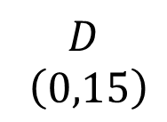

Quadrilateral Angles
SIC_88
$$C \left(6,29\right)$$
(Not to scale)
$$D$$
$$\left(0,15\right)$$
$$B \left(41,14\right)$$
$$A \left(6,0\right)$$
V
Determine the angles in the quadrilateral using trigonometric compound angle formulae.
Notes:
X=5, y=2

Slide 33
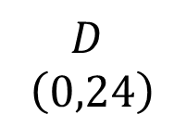

Quadrilateral Angles
SIC_88
$$C \left(6,34\right)$$
(Not to scale)
$$D$$
$$\left(0,24\right)$$
$$B \left(46,10\right)$$
$$A \left(6,0\right)$$
W
Determine the angles in the quadrilateral using trigonometric compound angle formulae.
Notes:
X=5, y=3

Slide 34
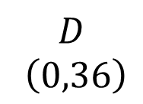

Quadrilateral Angles
SIC_88
$$C \left(4,41\right)$$
(Not to scale)
$$D$$
$$\left(0,36\right)$$
$$B \left(49,5\right)$$
$$A \left(4,0\right)$$
X
Determine the angles in the quadrilateral using trigonometric compound angle formulae.
Notes:
X=5, y=4

